Slide 1
Driver Drowsiness Detection
Using Neural Networks & Computer Vision
Jahnavi Bonagiri | Tobin Cherian | Evangeli Silva | Andrew Okoro

Slide 2
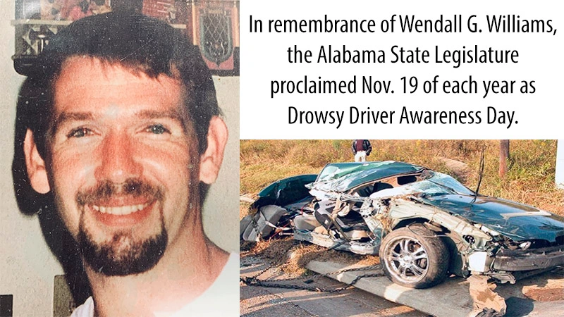
Overview
It is estimated that in 2017, 91,000 police-reported crashes involved drowsy drivers. These crashes led to an estimated 50,000 people injured and nearly 800 deaths. (NHTSA, 2019)
Monitoring facial expressions such as head movement and eye blinking can help diagnose if a driver is drowsy.
To prevent accidents, it is important to come up with detection systems that can alert if the driver is drowsy.

Slide 3
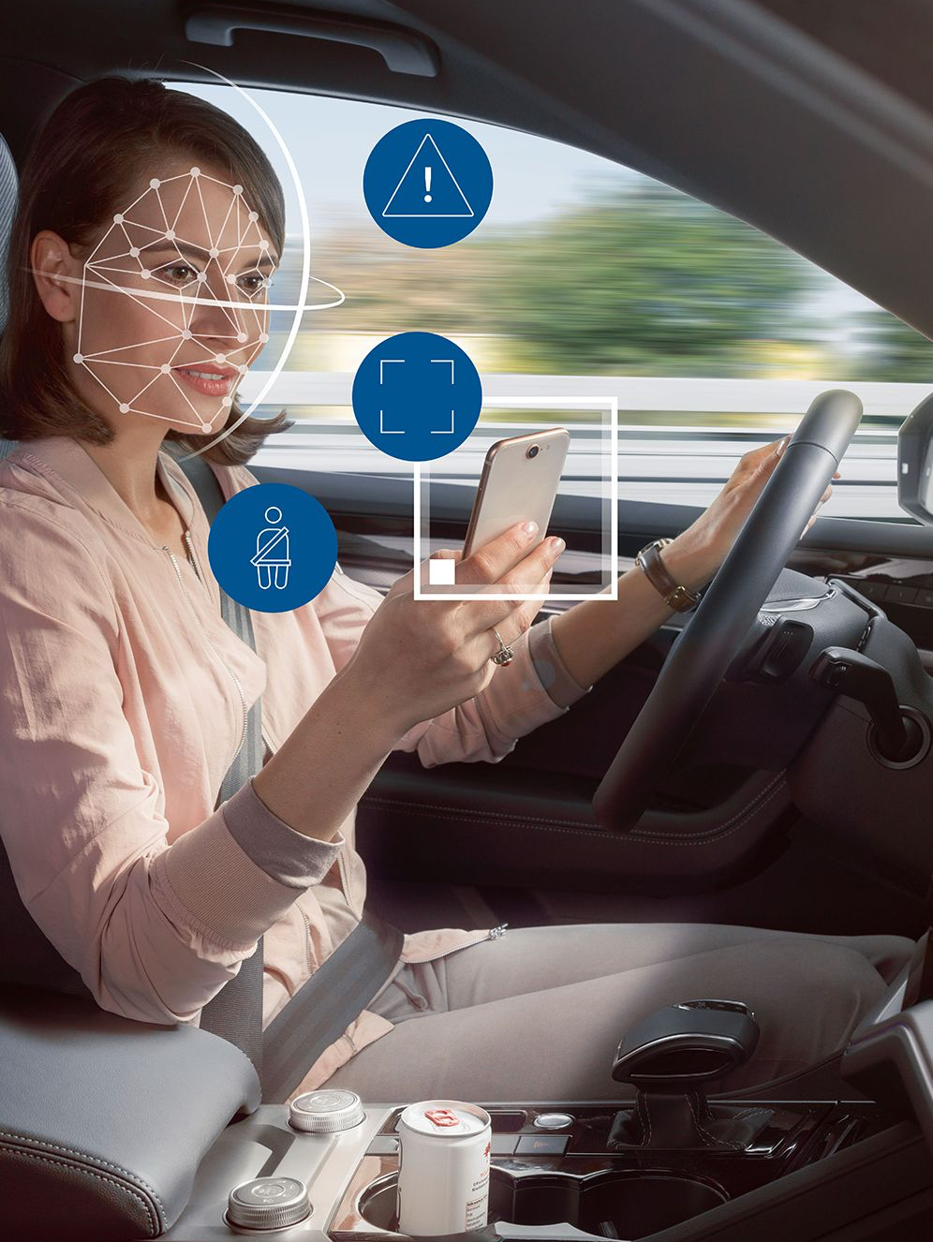
Objective
To develop a system that utilizes non-intrusive methods to accurately determine driver state in real-time and generate effective and acceptable warnings to increase driver alertness and safety.

Slide 4
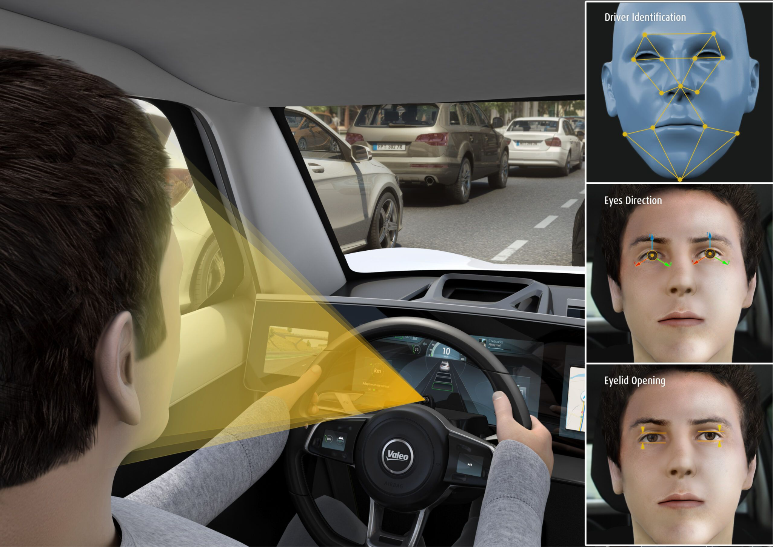
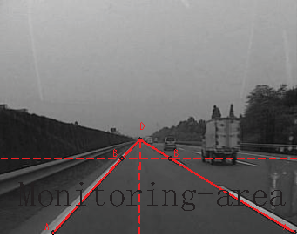
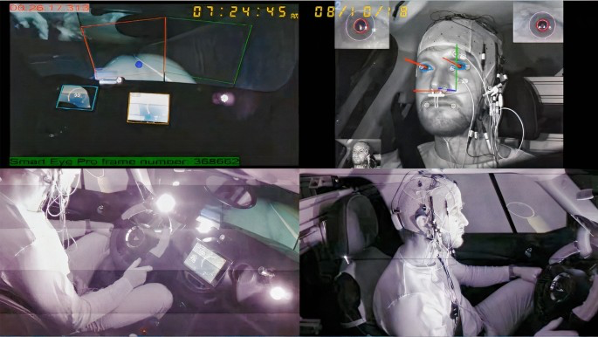
Various Approaches
Visual monitoring of the driver Optical sensor to detect head and/or eye gestures
Lane deviation monitoring Sensor monitors vehicle
Head nod monitoring Sensor to detect head movement
Activity monitoring Driver wears watch-type sensor that tracks of motion
Mental Reaction Time Measures driver’s reaction time to random warning

Slide 5
Our Approach
Monitor facial expressions, specifically eye closure time
Involves 2 phases:
Open/Close Eye Detection
Real-time Drowsiness Detection

Slide 6
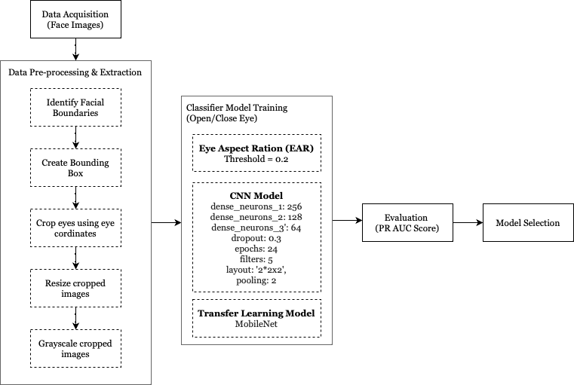
Phase 1: Open/Close Eye Detection

Slide 7
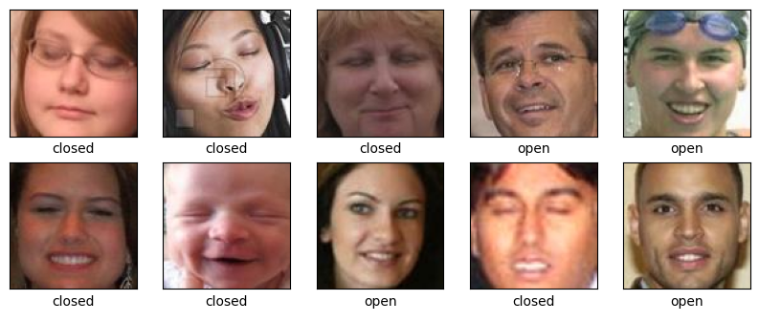
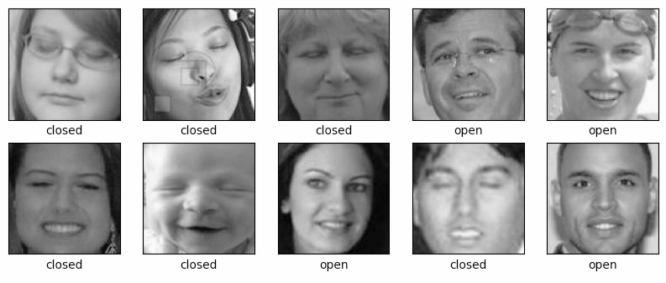
Data Sources
“Labeled Faces in the Wild” (link) Univ. of Massachusetts Amherst
18,983 photos of people with | both eyes open
“Closed Faces in the Wild” (link)
Nanjing Univ. of Aeronautics and Astronautics
1192 photos of people with | both eyes closed
Kaggle Dataset (link) Drowsiness Detection
Professionally taken close ups | images of 2,000 open and 2,000 closed eyes

Slide 8
Data Forms
Gray scale
RGB
High/Low quality
Male/Female
With glasses
Diverse facial structures
Different angles

Slide 9
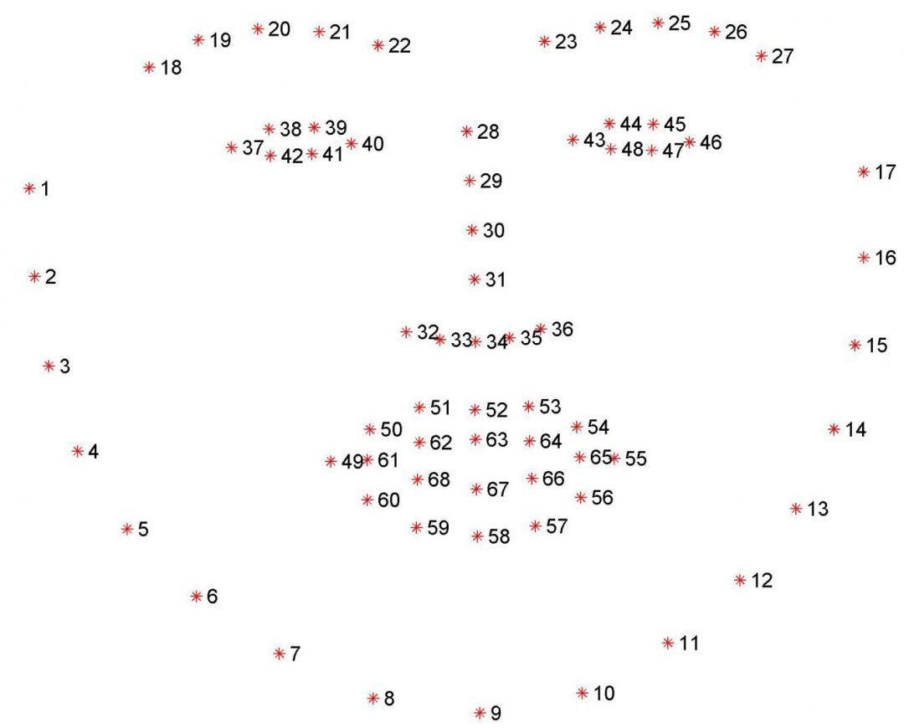
Pre-processing (Step 1: Identify Facial landmarks)
Used face_recognition library to detect the key facial structures on the face ROI.
face_recognition is built using dlib’s state-of-the-art face recognition and claims to have an accuracy of 99.38%.
dlib’s implementation of facial landmark detector uses a training set of labeled facial landmarks on an image. These images are manually labeled, specifying 68 (x, y)-coordinates of regions surrounding each facial structure.
Given this training data, an ensemble of regression trees are trained to estimate the facial landmark positions directly from the pixel intensities themselves.
Visualization of the 68 facial landmark coordinates from the iBUG 300-W dataset

Slide 10
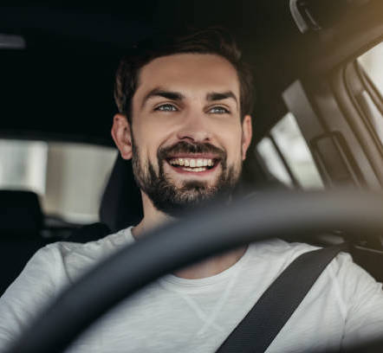

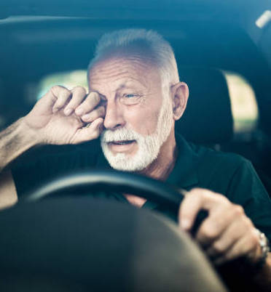

Pre-processing (Step 1: Identify Facial landmarks)
Facial structure coordinates represented as a line

Slide 11
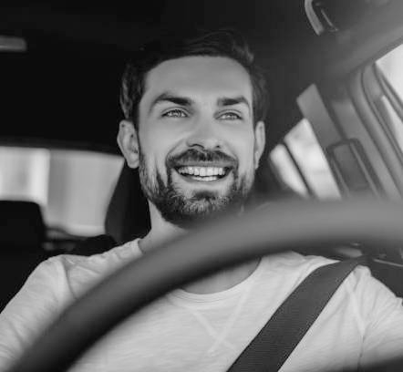
Pre-processing (Step 2: Crop Eye & Refine Further)
Cropped images, based on the (x,y)-coordinates of the eye (right eye points: 37–42, left eye points: 43–47).
To make sure the full eye is captured, the coordinates of a square that has 50% cushion were added to the axis
Finally, resized & gray scaled cropped images
A sample image after pre-processing

Slide 12
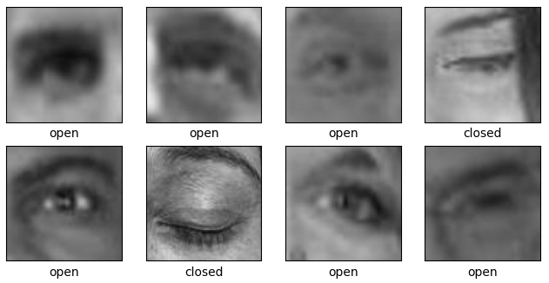
Pre-processing (Step 2: Crop Eye & Refine Further)
Sample images before & after pre-processing

Slide 13
Model Training (Open/Closed Eye Detection)
We explode the following methods:
Mathematical approach using eye aspect ratio (EAR)
Building a CNN model from scratch for Image Classification
Transfer Learning (Image classification with transfer learning by fine-tuning a pretrained CNN model)

Slide 14
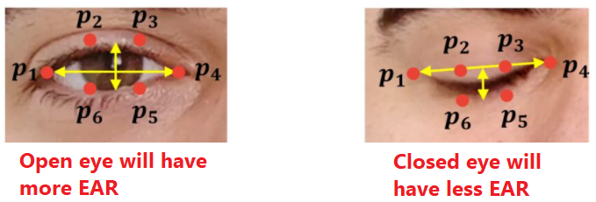
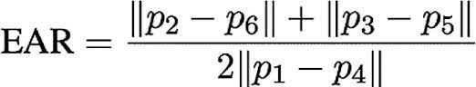
Approach 1: Eye Aspect Ratio (EAR)
Computed based on the (x,y)-coordinates of the eye
P2, P3, P5, and P6 key points are the value of longitudinal coordinate, P1 and P4 key points are the value of horizontal coordinate.
EAR is calculated using the euclidean distance between key points around the eye.

Slide 15
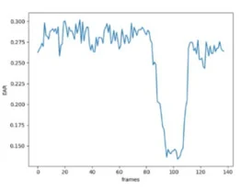
Approach 1: Eye Aspect Ratio (EAR)
According to T Zhu et al (2022), when EAR > 0.2, it is identified as an open eye, else a closed eye.
This was adopted to detect open/closed eye.
Observation:
EAR fluctuates greatly when given an image of an eye with glasses

Slide 16
Approach 2: Convolutional Neural Network (CNN)
Hyper-parameter Tuning Around 100 models were trained & evaluated varying the parameters Based on Grid Searching using k-fold cross validation (k = 3)
Convolutional Layers (Number of layers: 1, 2, 3, 4, 5)
Filters (Number of filters: 8, 16, 32 | Size of filters: 3x3, 5x5)
Pooling (Pooling of features 2x2: Yes, No)
Dense Layers (Number of Layers: 1, 2, 3 | Neurons: 64, 128, 256, 512, 1024)
Dropout: (Percentage: 10%, 20%, 30%, 40%, 50%)

Slide 17
Approach 2: Convolutional Neural Network (CNN)
Scoring the Model (Top 5 scores)
Dense Layer 1 Neurons | Dense Layer 2 Neurons | Dense Layer 3 Neurons | Dropout Rate | Number of Iterations | Input Filters | Shape of Filters | Pooling Layer | Average Test Score
256 | 128 | 64 | 0.3 | 24 | 32 | 3x3 | Yes | 0.9631
256 | 512 | 1028 | 0.4 | 30 | 32 | 3x3 | Yes | 0.9614
256 | 512 | 1028 | 0.3 | 30 | 64 | 3x3 | Yes | 0.9610
128 | 128 | 128 | 0.1 | 10 | 32 | 5x5 | No | 0.9123
128 | 128 | 128 | 0.1 | 10 | 16 | 3x3 | No | 0.9028

Slide 18
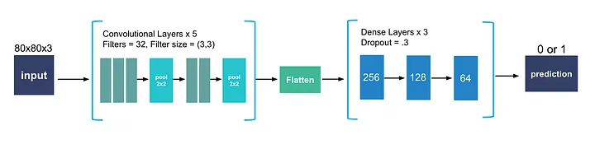
Approach 2: Convolutional Neural Network (CNN)
Final Network Architecture
Convolutional Layers: ‘ReLU’ activation function (helps to prevent the exponential growth in the computation required to operate the neural network)
Output Layer: ‘Sigmoid’ activation function (maps input values to a value between 0 and 1)
Model Compilation using ‘Adam’ optimizer (have faster computation time, and require fewer parameters for tuning)
24 Epochs (diminishing returns after 20 epochs)

Slide 19
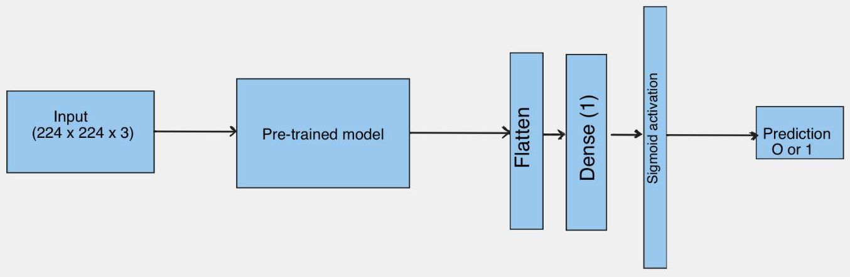
Approach 3: Transfer Learning
Image classification with transfer learning by fine-tuning the pretrained MobileNet CNN model
MobileNet is pre-trained on MobileNet dataset
Removed the output layers of the model
Add layers: flatten and dense
Sigmoid Activation function for the binary classification
Binary cross entropy loss function
Optimizer is Adam
Early_stop and callbacks to monitor when the val_loss is not improving as the number of epochs increased.

Slide 20
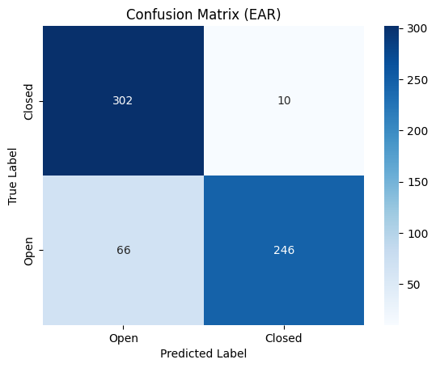
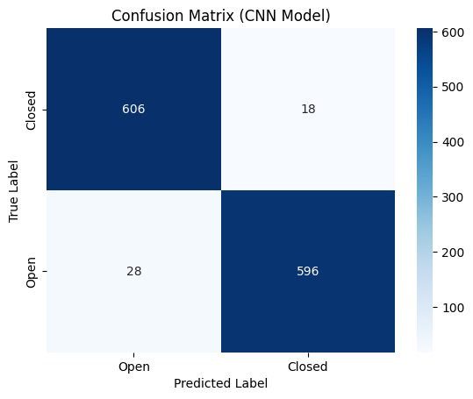
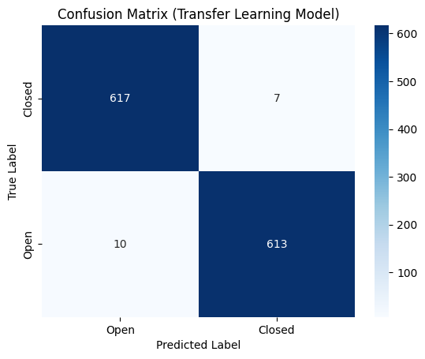
Model Evaluation: Confusion Matrix

Slide 21
Evaluation Matrix
Metrics | EAR Based Classification (Threshold = 0.2) | CNN Model | Transfer Learning
Accuracy | 87.82% | 96.31% | 98.6%
Precision | 96.1% | 97.07% | 98.87%
Recall | 78.84% | 95.51% | 98.39%
F-Measure | 86.62% | 96.28% | 98.63%

Slide 22
Model Evaluation: PR AUC Score
Our primary metric was the Precision-Recall Area under the Curve score (PR AUC). The “baseline” score for this metric is 0.5 for both precision and recall, and in a perfect classifier it is 1.
The PR AUC score places the most importance on how well we predict positives (a driver is asleep), which is more important to us than predicting negatives (a driver is awake).
The area under the curve represents the proportion of true positives to false positives and false negatives.

Slide 23
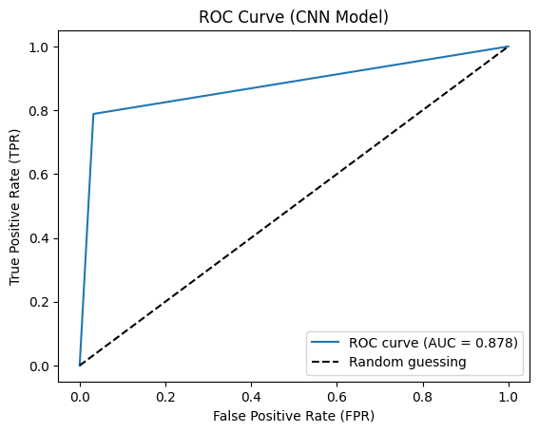
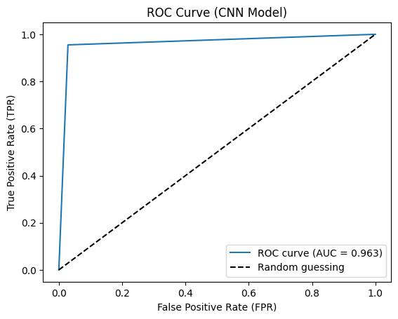
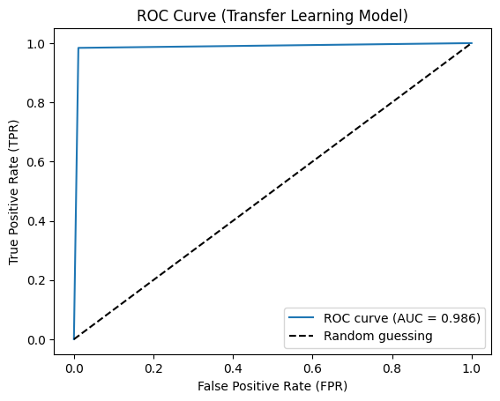
Model Evaluation: PR AUC Score

Slide 24
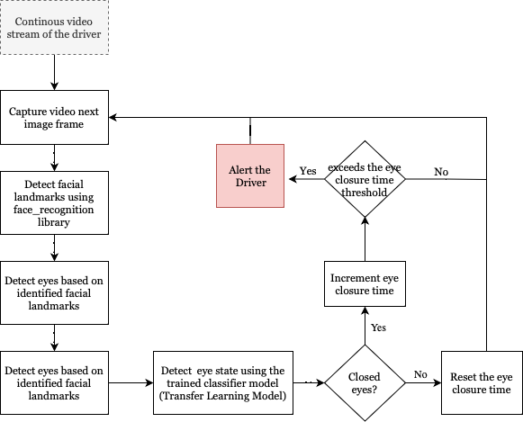
Phase 2: Real-time Drowsiness Detection

Slide 25
Phase 2: Real-time Drowsiness Detection
Eye Closure Time
According to the Journal of Safety Research in 2009, reported that the mean duration of eyelid closure prior to a simulated crash was 3.79 seconds, and that eyelid closure durations of 2 seconds or longer were highly indicative of drowsiness.
Also, the Journal of Sleep Research in 2018 found that a duration of eyelid closure of 2 seconds or more was associated with increased levels of drowsiness and impaired driving performance
Hence, the closure time of 2 seconds was adopted to detect drowsiness

Slide 26
Limitations and Improvements
Proximity to camera: Our system may not work properly when the camera is far from the person.
The system is sensitive to the lightening condition in the environment.
Apply data augmentation by applying transformations like flip, crop, rotations, to the data set, this will increase the size of the dataset and make the model more robust to variations in the input.

Slide 27
Demo

Slide 28
References
https://towardsdatascience.com/drowsiness-detection-with-machine-learning-765a16ca208a
A. Mittal, K. Kumar, S. Dhamija, and M. Kaur, “Head movement-based driver drowsiness detection: A review of state-of-art techniques,” In 2016 IEEE International Conference on Engineering and Technology (ICETECH), Coimbatore, India, 2016, pp. 903-908.
Q. Ji and X. Yang, “Real-Time Eye, Gaze, and Face Pose Tracking for Monitoring Driver Vigilance,” Real-Time Imaging, vol. 8, no. 4, pp. 357–377, 2002.
https://docs.opencv.org/trunk/d7/d8b/tutorial_py_face_de tection.html
A Robust Algorithm for Eye Detection on Grey Intensity Face without Spectacles- JCS&T Vol. 5 No. 3
Karamjeet Singh,Rupinder Kaur,”Physical and Physiological Drowsiness Detection Methods”, IJIEASR, pp.35-43,vol.2,2013.
Jarek Krajewski,David Sommer,”Steering Wheel Behavior Based Estimation Of Fatigue”, Fifth International Driving Symposium on Human Factors in Driver Assessment, Training and Vehicle Design, Germany.

